Slide 1

Command Line Basics 1/2
Linux Essentials
Session-2
Notes:
Good evening ladies and gentelman. I hope you are all doing good. Today, we will discuss Command Line Basics and generally shells. And more importantly, we will start doing hands on practices.
what linux is free, open source and OS
why is it so preferable, most known in IT area
what is its history, important turning points in the history like kernel, distros, mobile OS, Git etc
what is its components etc like after boatloader kernel, CLI,Xserver,GUI and applications
A kernel is the foundational layer of an operating system (OS). It functions at a basic level, communicating with hardware and managing resources, such as RAM and the CPU. Since a kernel handles many fundamental processes, it must be loaded at the beginning of the boot sequence when a computer starts up
Operating system is system program that runs on the computer to provide an interface to the computer user so that they can easily operate on the computer. Kernel is also a system program that controls all programs running on the computer. Kernel is basically a bridge between software and hardware of the system.
brain of the OS

Slide 2
Table of Contents
What is SHELL?
Basic SHELL Commands
Case Sensitivity
Simple Globbing
Notes:
Here are the topics we will cover during this session. The most important title here is the shell. Though we will not go deeper about theoretic foundations of the shell, we will start to use it in this session.

Slide 3

What is SHELL?
1
Notes:
So, what is shell? Any idea?

Slide 4
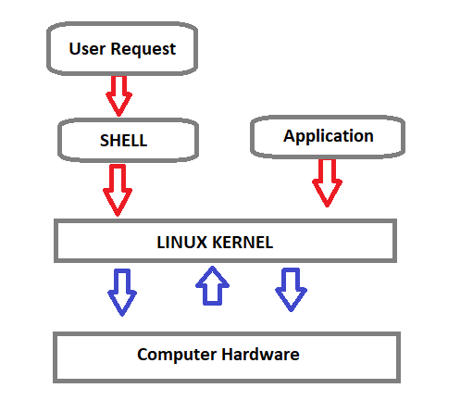
What is SHELL?
Shell is a program that receives the user's commands and gives them to the operating system to process and displays the output.
Bash (Bourne Again SHell) is an enhanced version of Steve Bourne's first Unix shell application, and serves as the shell program on most Linux systems.
Notes:
Shell is a program that receives the user's commands and gives them to the operating system for processing and displaying the output. Its distros come in the GUI, but essentially Linux has a CLI (command-line interface).
The shell is basically a program that takes keyboard commands and gives them to the operating system to conduct. A program called bash, serves as the shell program on most Linux systems (which stands for Bourne Again SHell, an enhanced version of Steve Bourne's first Unix shell application, sh).
https://www.journaldev.com/39194/different-types-of-shells-in-linux

Slide 5

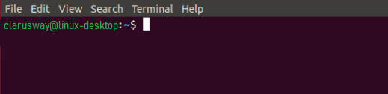
What is SHELL?
The standard Linux shell is both a command-line interpreter and a programming language.
The command prompt for Linux generally shows the current user, the current host, and the appropriate directory.
At the end of the prompt list, the $(dollar sign) signifies the current user being unprivileged, and the device is ready to receive feedback.
The input is sent for parsing and execution to the interpreter.
Notes:
The standard Linux shell is both a command-line interpreter and a programming language.
The command prompt at the beginning of the command line is a short text string. The command prompt for Linux generally shows the current user, the current host, and the appropriate directory.
The prompt of the command can be easily modified to display as desired more or less information. At the end of the prompt string, the $ (dollar sign) signifies that the current user is unprivileged, and the device is ready to receive feedback.
The input is sent for parsing and execution to the interpreter. The most common interpreter is BASH or the Bourne Again Shell, but there are others available, some of them are using different signs instead of the dollar sign.
some uses % instead of $ sign

Slide 6
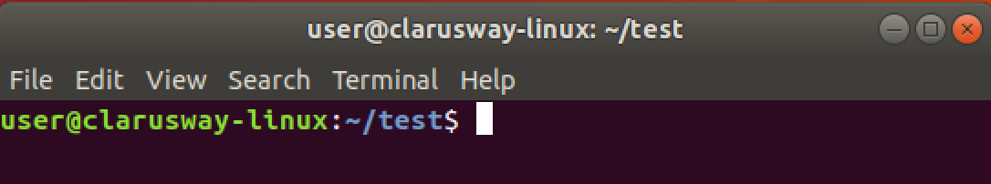
Command Prompt
User Name
Host Name
Current Directory
User Type
$ normal user
# Privileged user
Notes:
When we look deeply at the command prompt we see some details about our environment. For example, here, user refers to the current logged on user. And host name is generally the machine being used. Then, the current directory, where the user is working on and lastly user type, which is a $ sign means the current user is a normal user without extra privilages.

Slide 7
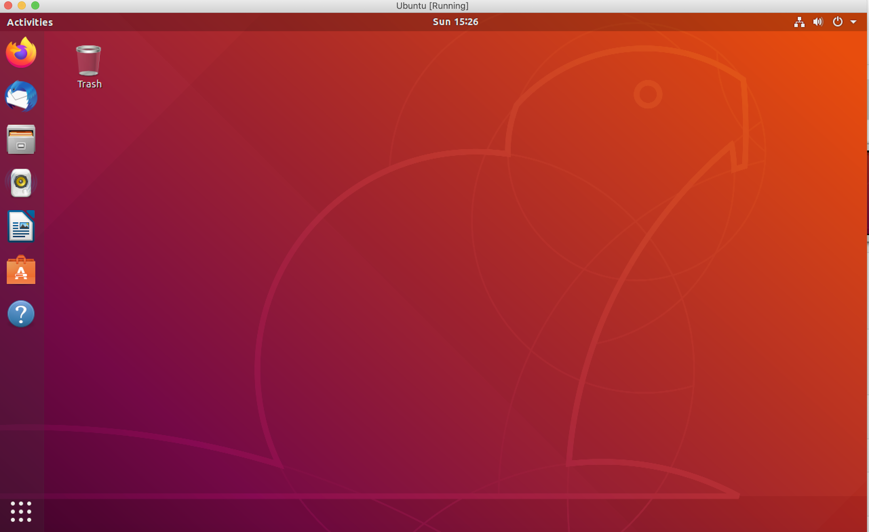
GUI

Slide 8
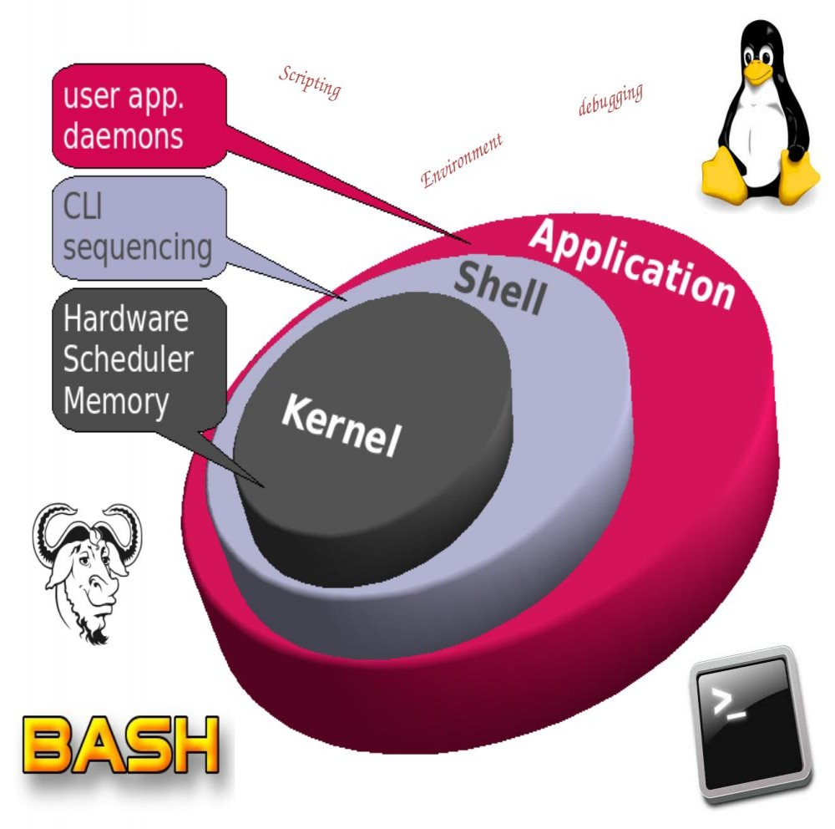
Basic SHELL
Commands
2
Notes:
At last, we can do some practice.
Now, let’s get our hands dirty guys. Before continuing, please start your shells, or open Linux simulators on your browsers.

Slide 9
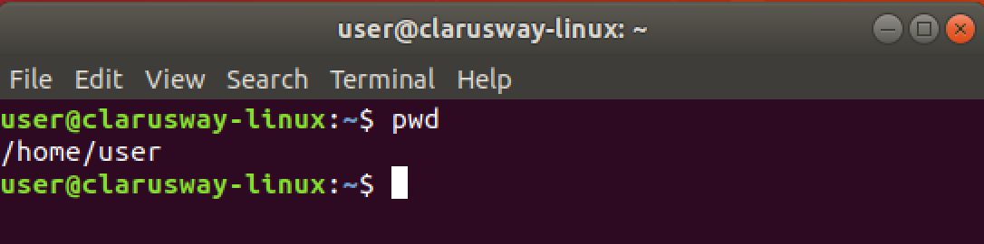
Basic Shell Commands
pwd show current path
Notes:
Though you can see the current path on your command prompt, the most used command, in my opinion, is pwd.
It is my habit to look and confirm my working directory by using this command. Especially if you are the root user, it becomes more important to know where you are on the system. I do also suggest you use this command first ..
Let’s do it together please...

Slide 10
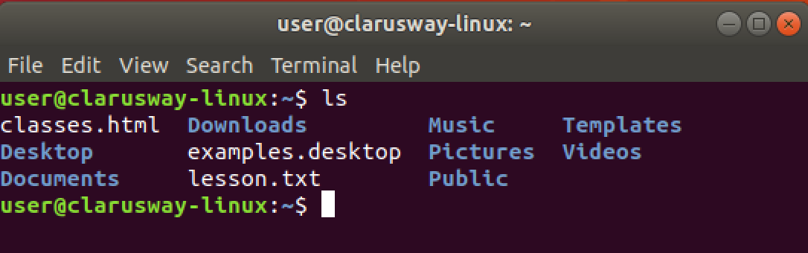
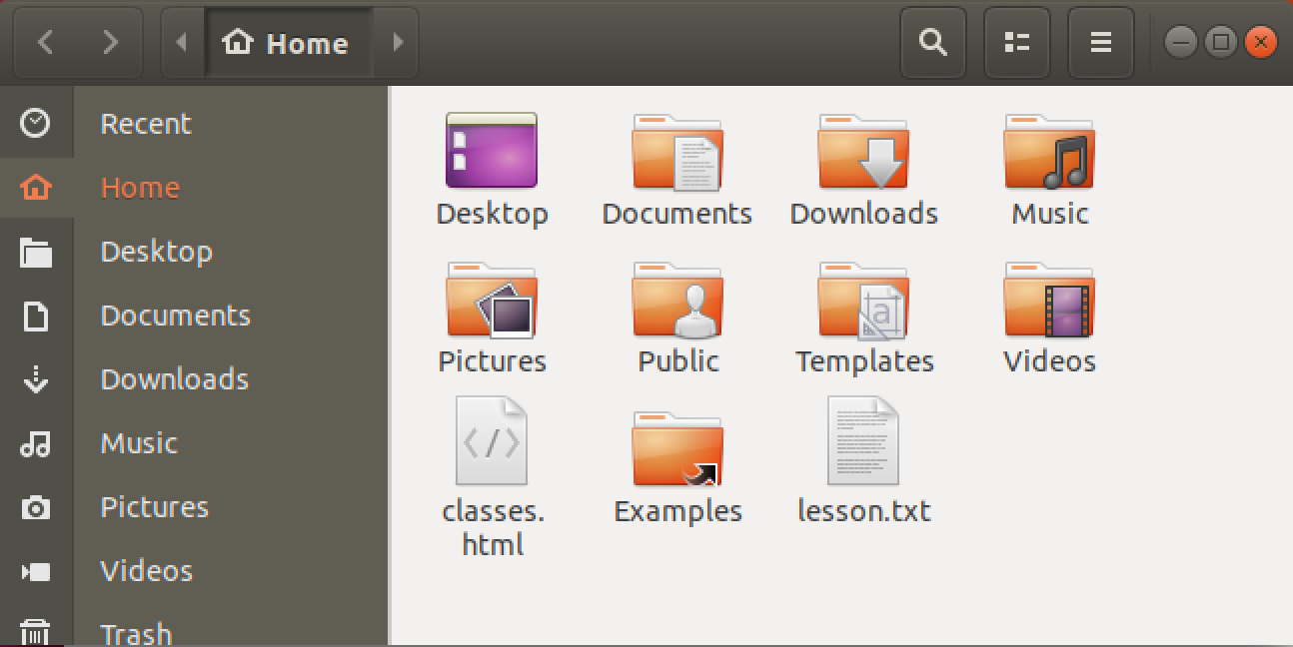
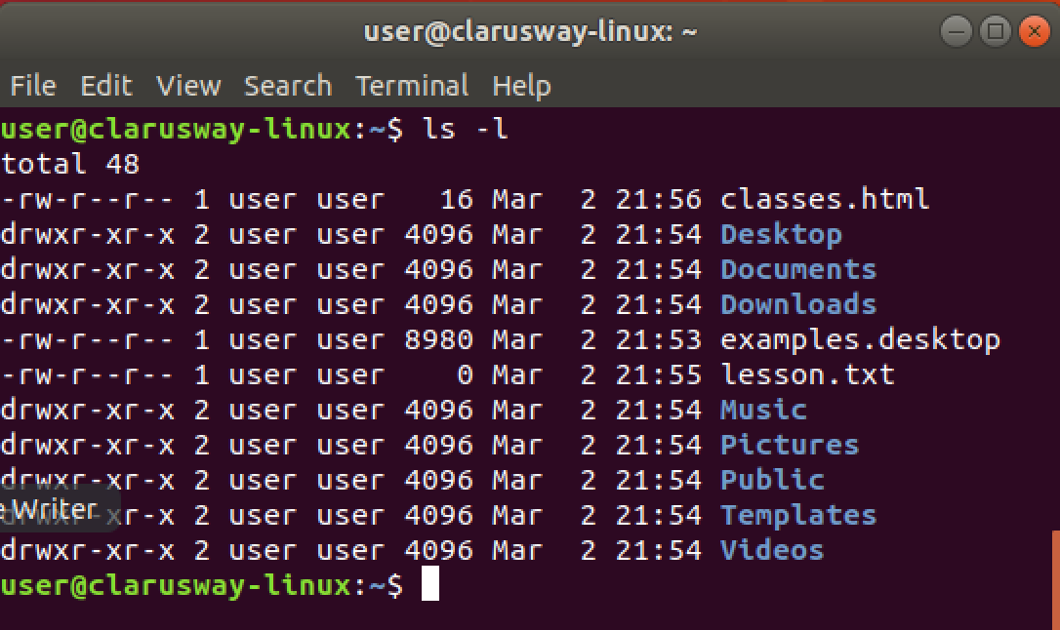
Basic Shell Commands
ls lists directory contents
ls -l lists directory contents with details
Notes:
ls, means list directory contents, is the most used command with pwd in Linux, I think.
It has many arguments, I mean options.
ls -l, ls -a, and ls -al are mostly used options for ls command. it should be space between options and command
Let’s check the contents of our current directories with different arguments.

Slide 11
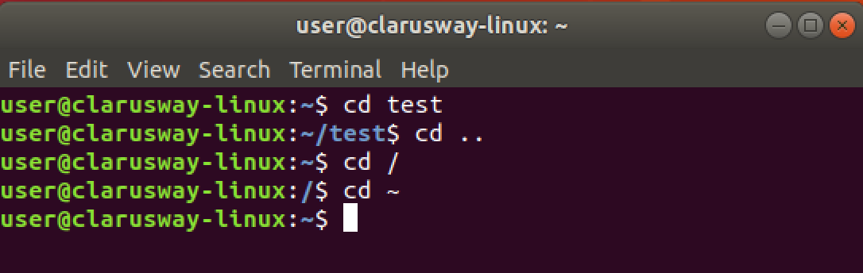
Basic Shell Commands
cd [dir] change (current) directory
cd .. change current directory to one level up
cd / change current directory to the root directory
cd ~ change current directory to the home directory

Slide 12
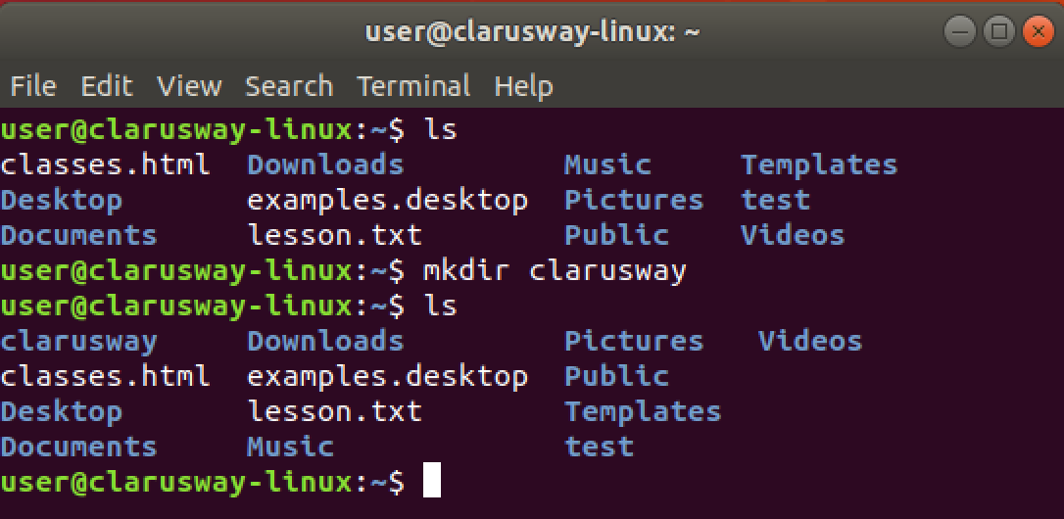
Basic Shell Commands
mkdir [dir] create a new directory

Slide 13
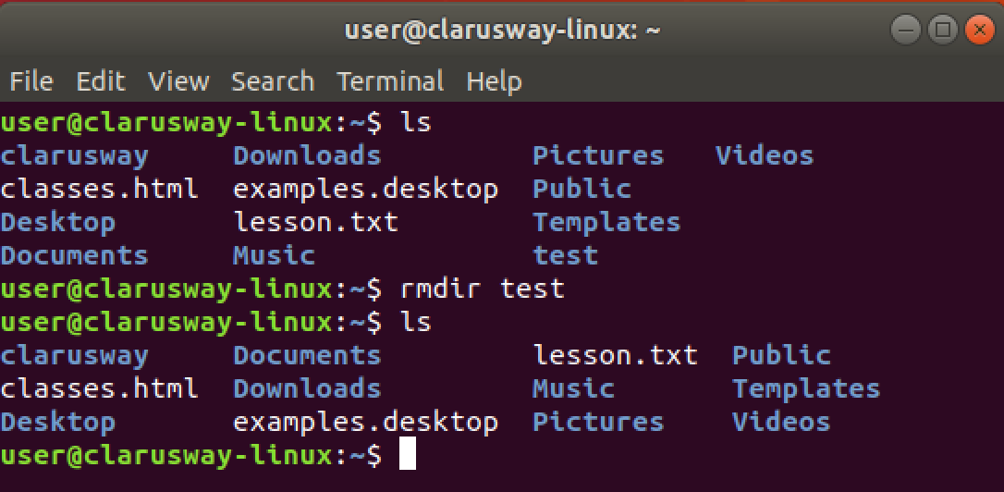
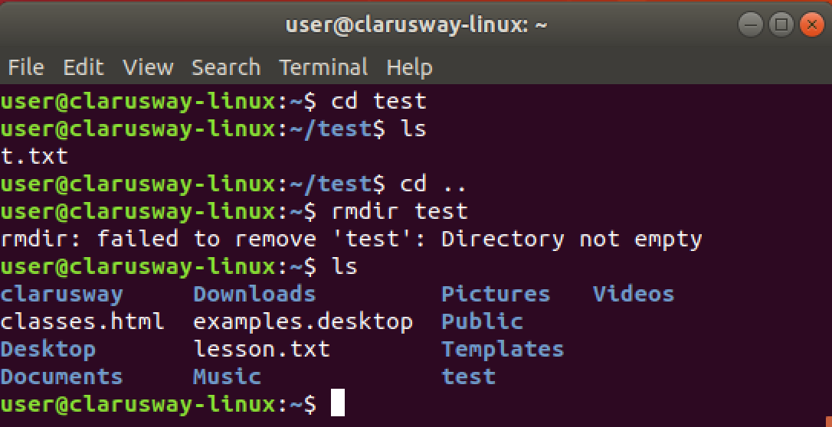
Basic Shell Commands
rmdir [dir] delete an empty directory

Slide 14
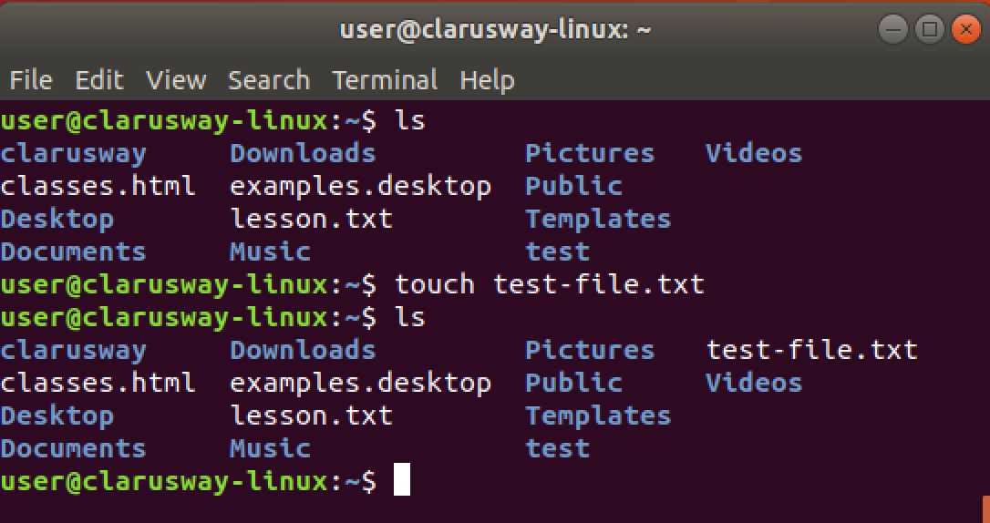
Basic Shell Commands
touch create a file
Notes:
to create an em

Slide 15
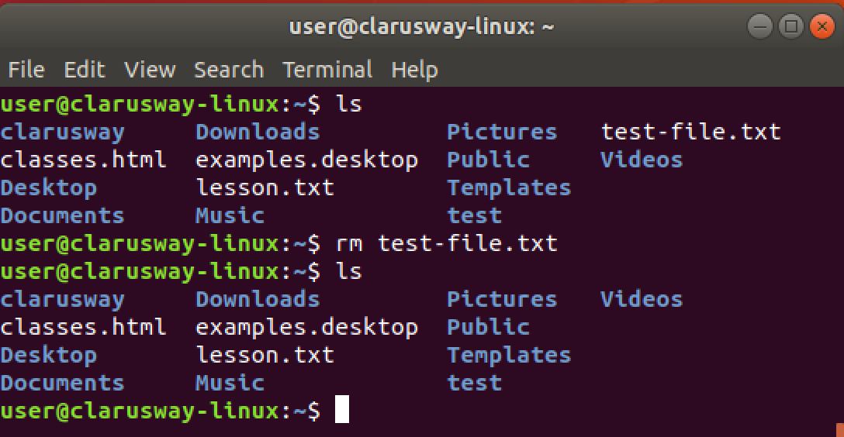
Basic Shell Commands
rm delete a file

Slide 16
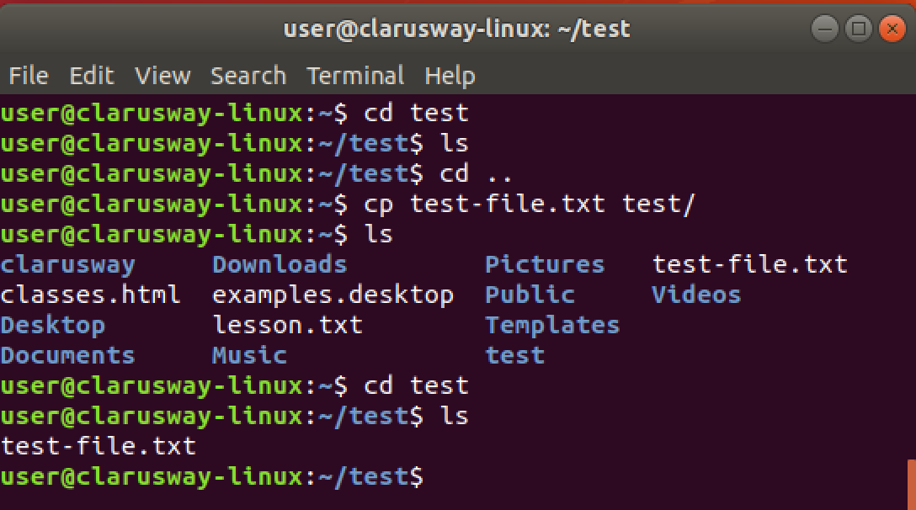
Basic Shell Commands
cp copy a file to another location

Slide 17
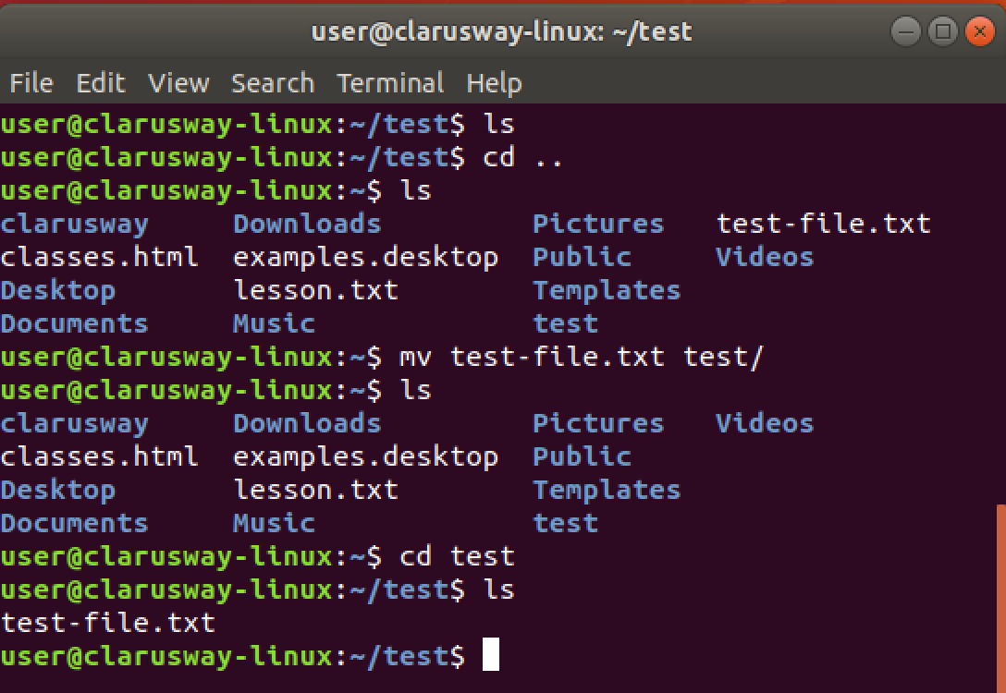
Basic Shell Commands
mv move a file to another location

Slide 18
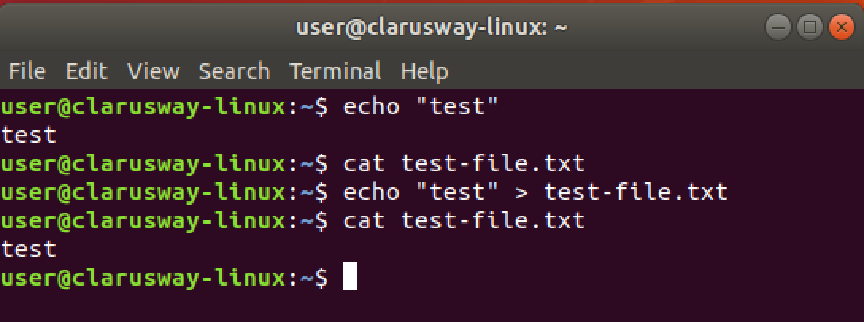
Basic Shell Commands
echo print message to screen
echo > [file] print message into a file

Slide 19
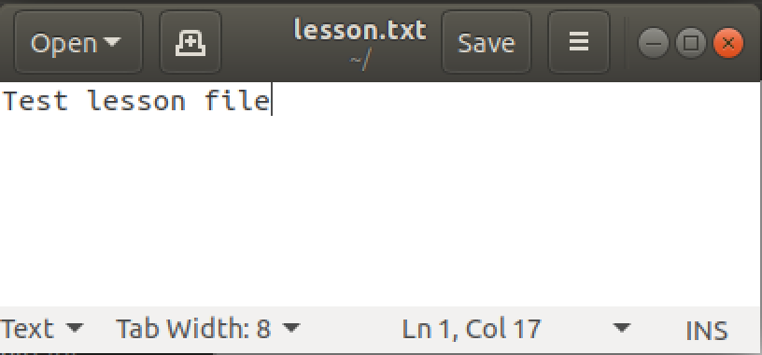
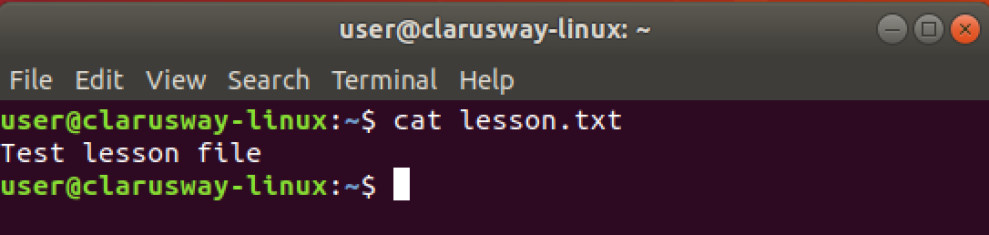
Basic Shell Commands
cat show file contents
Notes:
more

Slide 20
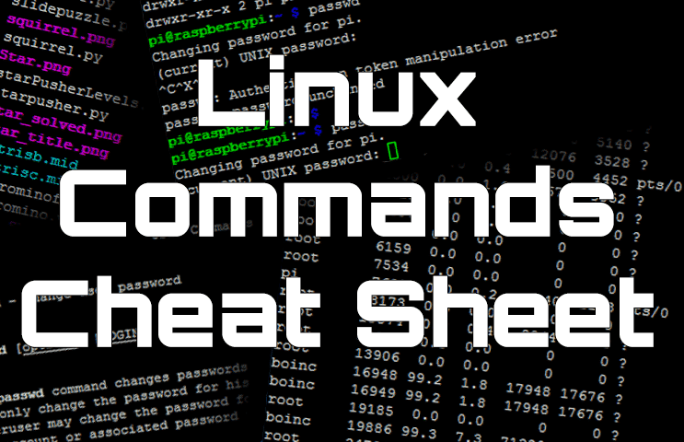
Basic SHELL Commands
Notes:
There are hundreds of commands on Linux systems and it is not possible for us to explain each of them one by one. You can search internet for cheat sheets and check different commands.
Linux commands may seem intimidating at first glance if you are not used to using the terminal. There are many commands for performing operations and processes on your Linux system.
No matter whether you are new to Linux or an experienced user, having a list of common commands close at hand is helpful.
for exp
The more you use Linux commands, the better you will get at remembering them. Do not stress about memorizing their syntax; use our cheat sheet.;
https://phoenixnap.com/kb/linux-commands-cheat-sheet

Slide 21


Slide 22

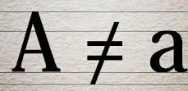
Case Sensitivity
Most of the common Linux file systems are case sensitive; this is something to keep in mind when creating files or directories and moving through directories.
Lower-case and upper-case letters have different ASCII representation.
touch newfile
touch Newfile
Will create two different files.
Notes:
Let’s try together:
touch newfile
touch Newfile
ls -l
uppercase letter
lower case

Slide 23


Task
clarusway
materials
lms.txt
pre-class
try-it.txt
post-class
lessons
linux.txt
“I love linux”
html.txt
“I can create a website”

Slide 24
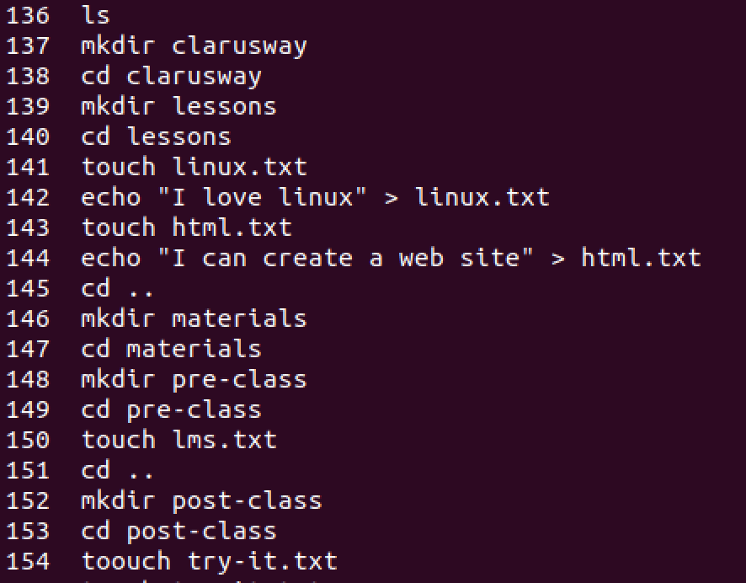
Solution

Slide 25
Simple Globbing
Globbing is primarily used to match patterns in filenames or text by using a wildcard character to create a pattern.
Character | Name | Function
? | Question mark | Match any single character
* | Asterisk | Match any number of character(s)
[] | Brackets | Match character from a range
^ | Caret | Used to match starting character
$ | Dollar sign | Used to match ending character
{} | Curly brace | Used to match more than one pattern
| | Pipe | Used for applying more than one condition
Notes:
File globbing is a feature provided by the UNIX/Linux shell to represent multiple filenames by using special characters called wildcards with a single file name. A wildcard is essentially a symbol which may be used to substitute for one or more characters.

Slide 26
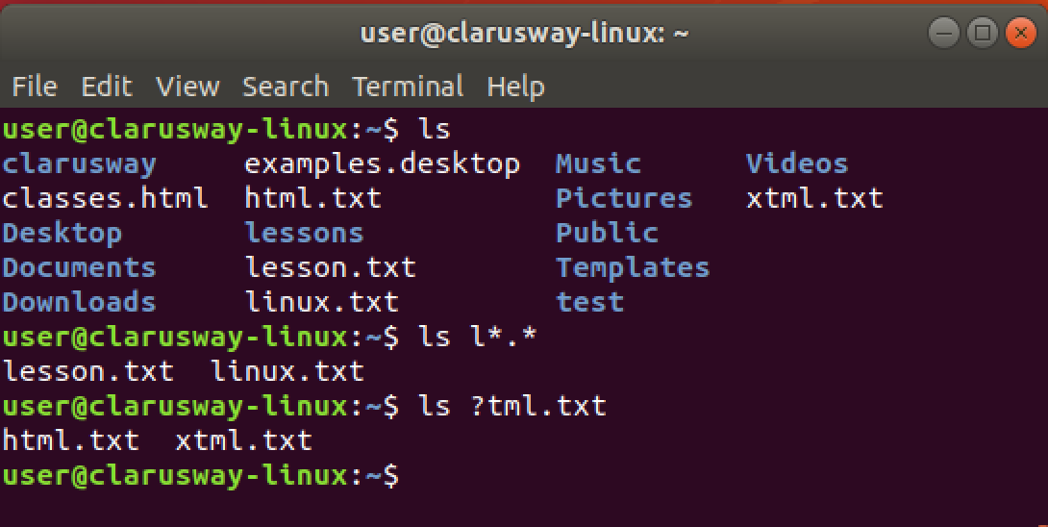
Multiple File/Directory Operations
? used for a single character
* used for multiple characters.

Slide 27
THANKS !
Any questions?

